Slide 1
Track and Field Recruiting Application
Gabe Conlon, Mark Franklin, Carter Comito

Slide 2
Description
Client
Whitworth Track and Field Team
Needs
Organize Recruiting Info
Combine all Coaches Data
Specific Queries

Slide 3
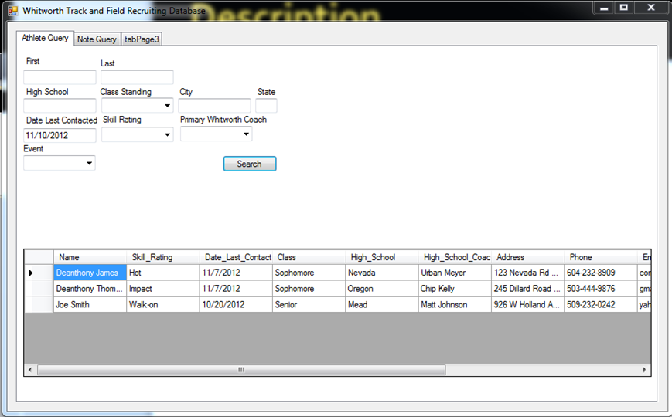
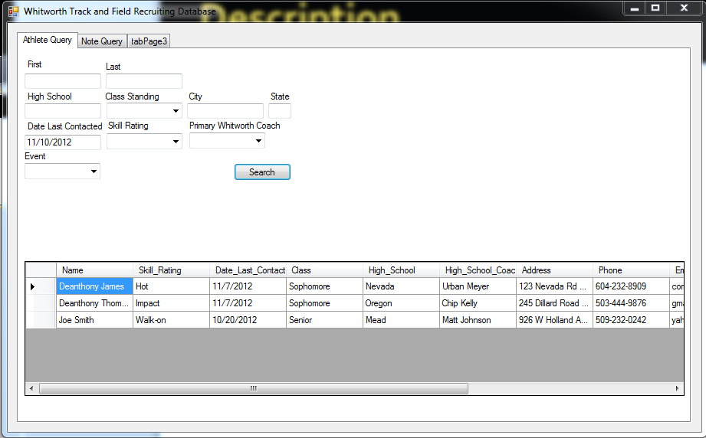
Screenshot

Slide 4
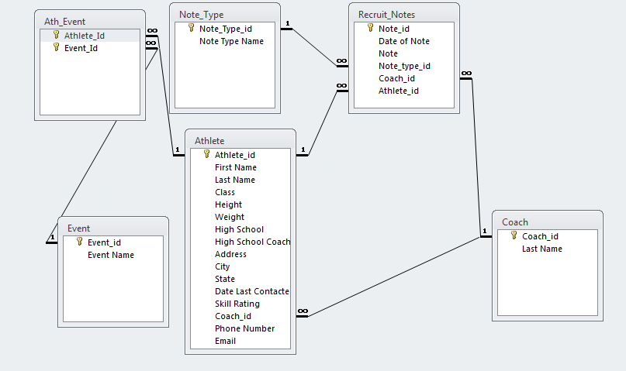
Logical Diagram

Slide 5
Discussion
Applied
Queries
Limited Redundancy
Many-to-many relationships
LINQ
Not-Applied
Advanced Query Techniques

Slide 6
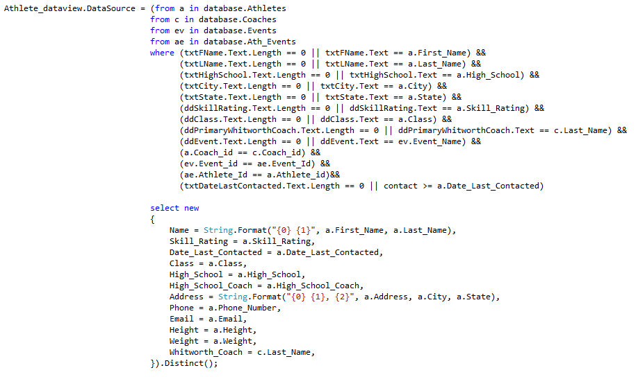
Queries

Slide 7
Post-Mortem
Demo
Queries
Were able to include all of coaches requests
Fully functional
Neat
Modifying Database
Adding Data
Updating Data
UI

